Slide 1


IMAGE CLASSIFICATION USING CNN AND TRANSFER LEARNING
By: Anirudh Unni, Natalia Dominguez and Zahory Vasquez

Slide 2



Overview
Project Overview
03
Dataset Description
04
Data Preprocessing
05
Custom CNN
06
Architecture & Training
Evaluation & Improvements
CNN Evaluation
07
Transfer Learning Approach
09
Performance Comparison
07
Conclusions
11
Future Work
11

Slide 3
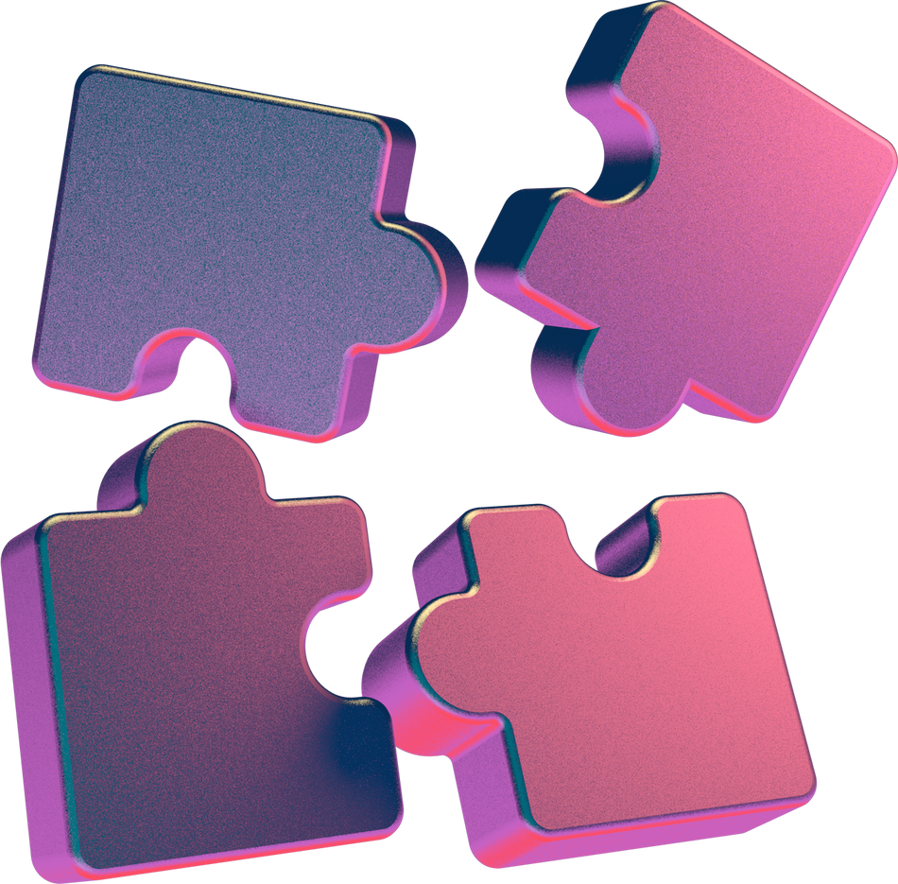
PROJECT OVERVIEW
Goal:
Classify images from the CIFAR-10 dataset into 10 categories.
Approaches:
Custom CNN built from scratch.
Transfer Learning using pre-trained models.

Slide 4
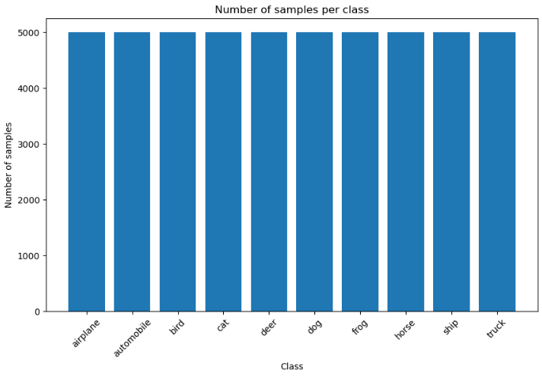
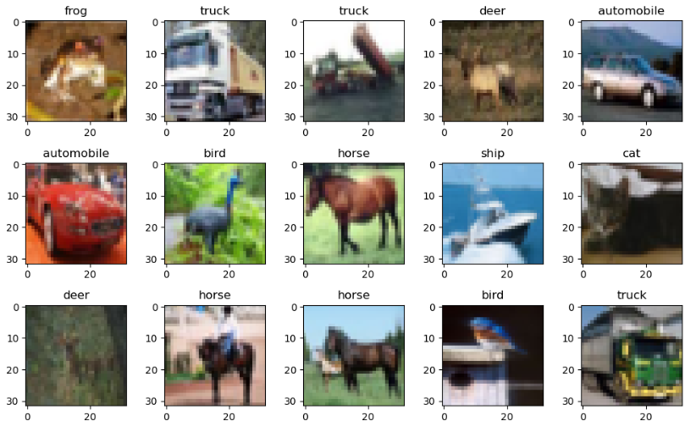
DATASET DESCRIPTION
Dataset: CIFAR-10
Size: 60,000 color images (32×32 pixels).
Classes: 10 categories

Slide 5

DATA PREPROCESSING
Before training, the dataset must be prepared to fit the model:
Reshape: Adjust input images to include the channel dimension required by CNNs.
Normalize: Scale pixel values to the [0, 1] range to improve training efficiency.
Encode: Convert class labels into one-hot vectors for multi-class classification.
Implementation uses Keras utilities:
Rescaling for normalization
to_categorical for label encoding

Slide 6
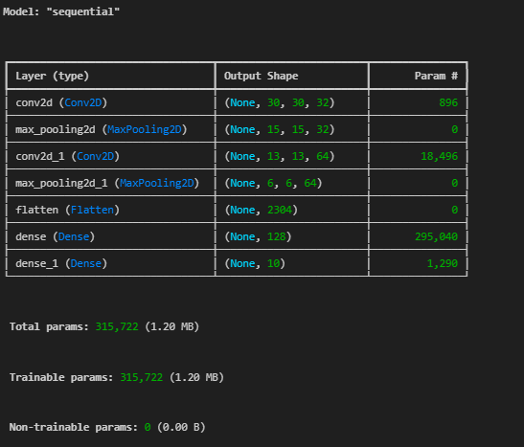
CUSTOM CNN
ARCHITECTURE & TRAINING
Model Architecture:
Convolutional layers with ReLU activations
MaxPooling layers for feature reduction
Flatten layer → Fully Connected dense layers
Model Training:
Optimizers: Adam
Loss function: Categorical Crossentropy

Slide 7
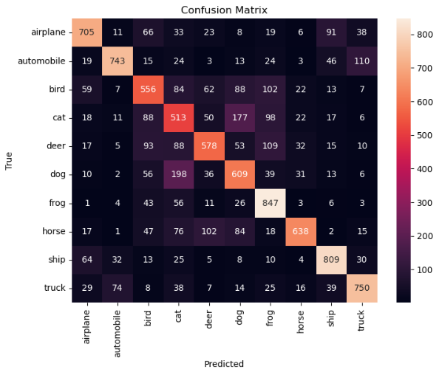
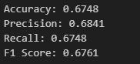
CUSTOM CNN
EVALUATION & IMPROVEMENTS
Model Evaluation:
Metrics: Accuracy, Precision, Recall, F1-score
Confusion matrix to analyze class-level performance
Test
Training accuracy: 0.82

Slide 8
CUSTOM CNN
EVALUATION & IMPROVEMENTS
Improving the Model:
Added more convolutional layers for deeper feature extraction
Added 1 more layer (previously only had 2) + Dropout
Training accuracy: 0.85
Added BatchNormalization + GlobalAveragePooling2D
Training accuracy: 0.91
Added Regularizer
Training accuracy: 0.93
Added Hyperparameter turning - Earling Stopping
Training accuracy: 0.94
Applied data augmentation (rotations, flips, shifts) to improve generalization
Training accuracy: 0.74

Slide 9

TRANSFER LEARNING APPROACH
Instead of evaluating multiple architectures, our approach focused exclusively on MobileNetV2 (pre-trained on ImageNet). The model was tested in three different configurations, varying which layers were frozen and the extent of fine-tuning, in order to compare performance and training time.

Slide 10

METRICS & EVALUATION
Key Features
Results
Simple dense head: GlobalAveragePooling → Dense(128, ReLU) → Dense(10, softmax)
Training: 5 epochs, batch size 64
MobileNetV2.1
Dense head with dropout: GlobalAveragePooling → Dropout(0.3) → Dense(10, softmax)
Training: Frozen base first phase, 10 epochs, default batch size
MobileNetV2.2
Same architecture as V2.2
Training: Frozen base first phase, 10 epochs, batch size 64
MobileNetV2.3

Slide 11

CONCLUSIONS
FUTURE STEPS
Custom CNN (with Data Augmentation):
Solid baseline model.
Achieved moderate performance with accuracy = 0.7694.
Requires longer training time since all weights are learned from scratch.
Transfer Learning (MobileNetV2.1):
Achieved higher accuracy = 0.8658.
Faster convergence by leveraging pre-trained features.
Better generalization compared to training from scratch.
Takeaway:
Transfer learning is the recommended approach for similar image classification tasks.
Test other pre-trained models (e.g., EfficientNet, ResNet).
Fine-tune more layers for better feature learning.
Apply advanced data augmentation techniques.
Optimize hyperparameters for higher accuracy.

